Slide 1
Assignment
On the bottom of page 3 of the Activity Packet
Fill out the payroll tax notes from The Payroll Tax Link on our class webpage.
Upon completion, your instructor will sign the packet.
Go to google classroom and answer the questions Labeled "Tax Tutorial"

Slide 2
Payroll Withholding
Payroll Taxes: a percentage withheld from an employee's pay by an employer who pays it to the government on the employee's behalf:
Federal Income, social security and Medicare taxes are payroll taxes
FICA Tax: are the payroll taxes paid to Social Security and Medicare for retirement savings and insurance program
The following is withheld and paid for Social Security
6.2% of your gross earnings to Social Security
1.45% of your gross earnings to Medicare Taxes
Employers must match this
Match 6.2% of your gross earnings to Social Security
Match 1.45% Medicare Taxes

Slide 3
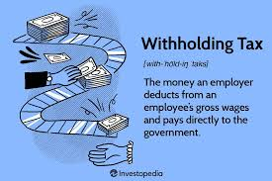
Five Types of Taxes Withheld
Federal Income Tax
Social Security Tax
Medicare Tax
State Income Tax
Local Income Tax

Slide 4
Check your Work
 | % paid by Employee | % paid by Employer | Benefits Provided
Social Security:
Medicare:

Slide 5
Payroll Taxes
Are withheld from every paycheck
Unlike Federal income tax, social security and Medicare is always taxable on every pay check – the standard deduction does not apply
The money paid toward social security and Medicare are fees that will be returned to you during your retirement years (62 and older)
A monthly social security check (this will be your income)
Medicare benefits (this is your medical insurance)

Slide 6
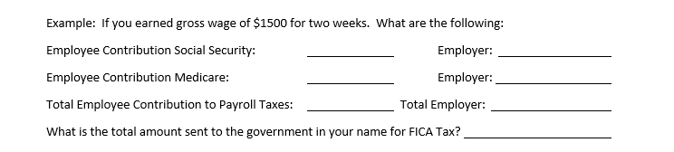
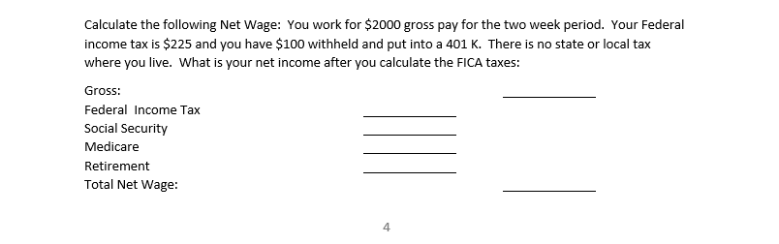
Check your Work

Slide 7
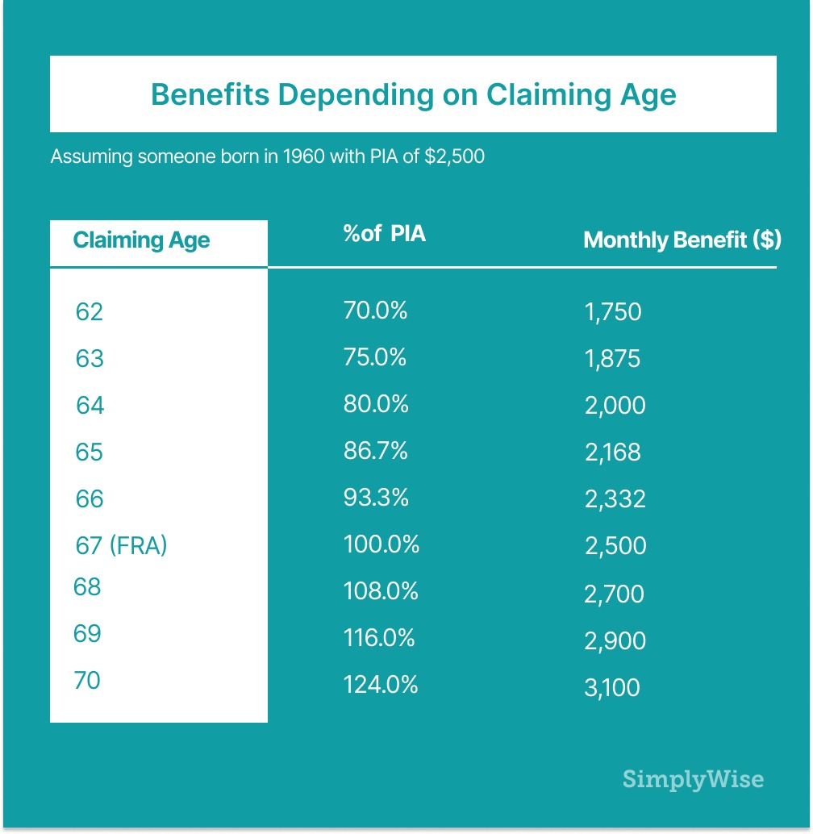
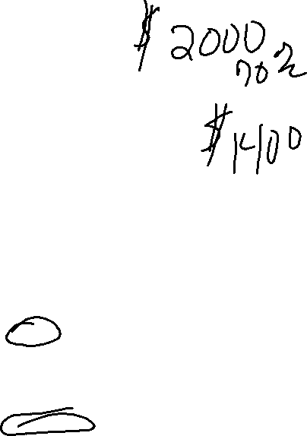
Retirement Benefits
Medicare begins at age 65
Social Security Benefits Age 62-70 or older:
Can begin at age 62, but reduce your payments by 30%
Full benefit for retirement is 67 years of age.
 |  |  | At Age 62 ^{3.}
Year of Birth |  | A $1000 retirement benefit would be reduced to | The retirement benefit is reduced by ^{4.}
1956 | 66 and 4 months | $733 | 26.67%
1957 | 66 and 6 months | $725 | 27.50%
1958 | 66 and 8 months | $716 | 28.33%
1959 | 66 and 10 months | $708 | 29.17%
1960 and later | 67 | $700 | 30.00%

Slide 8
Employment Forms
Continued

Slide 9
I-9 Forms: Employment Eligibility verification
Definition: Employment Eligibility verification form that states you are eligible to work in the US
Completed before you begin work
Verifies person is eligible to Work in US
Employer required to have on file for each employee
Requires two forms of ID, usually your drivers license and social security card
Can also use your passport

Slide 10
Work Together
Complete an I-9 Form

Slide 11
Form W-2: Wage and Tax Statement
Completed by employer – not employee
One from each job you held this past year
Used to File Your taxes by April 15
Maintain this on file with your taxes. Don’t throw it!!!
Required by Law to be mailed by January 31
If you don’t receive one by 31 Jan, call to request it

Slide 12
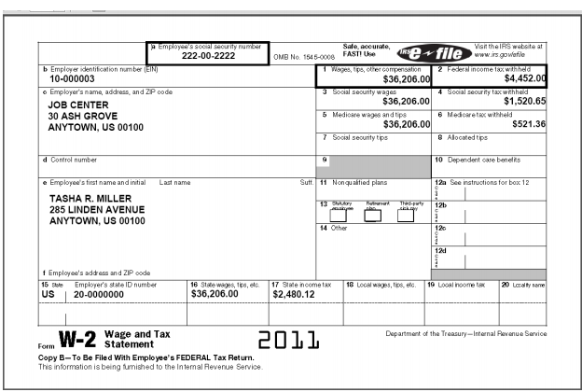
Form W-2: Wage and Tax Statement
Box 1: Gross income for the previous year
Box 2, 4 &6: All taxes paid from your check
Box 17 State Taxes - ND State Income Tax – between 1.10% - 2.90%

Slide 13
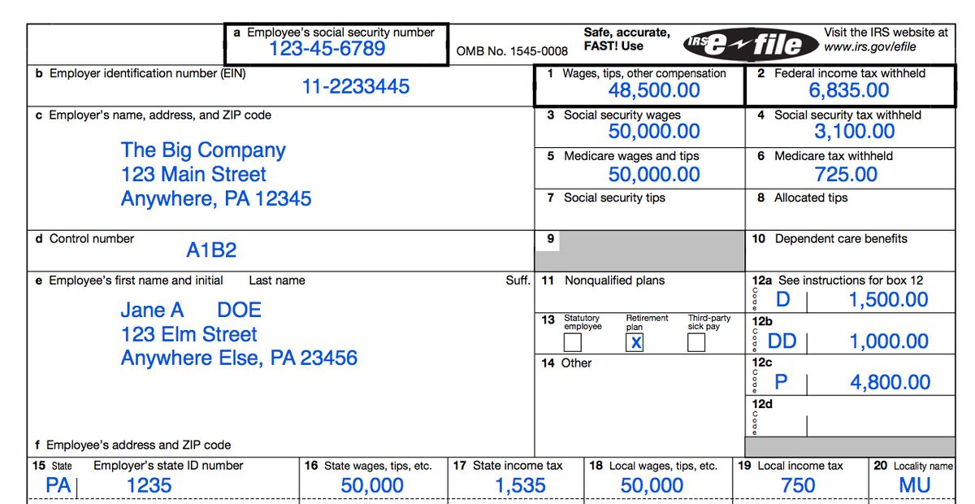
Form W-2: Wage and Tax Statement
SS wages higher as some items are non-taxable
Boxes 12 a, b, c, d are benefits paid for 401K

